Slide 1

Project Title -
Car Market Trends Analysis with Car
Dekho Data
Name - SHOAIB SW
College Name - East Point College of Engineering and Technology
Bengaluru, Karnataka
AICTE Student ID – STU68fa545b391751761236059

Slide 2

PROBLEM STATEMENT
The used car market involves multiple factors such as selling price, present price, vehicle age, kilometres driven, fuel type, seller type, transmission, and ownership. Without systematic data analysis, it can be difficult to identify meaningful market trends, understand price variations, and determine which factors are associated with car selling prices.
This project addresses this problem by analysing the Car Dekho dataset using Python to identify patterns, trends, and relationships in the used-car market.

Slide 3
Project Description
Car Market Trends Analysis is a data analytics project based on the Car Dekho used-car dataset. The project uses Python to load, clean, transform, and analyze the data to identify important patterns and trends in the used-car market.
Pandas is used for data manipulation and analysis, while NumPy is used for numerical calculations such as mean, median, minimum, maximum, and correlation.
A new Car Age feature is created from the manufacturing year to support further analysis. The project examines selling price, present price, kilometers driven, fuel type, seller type, transmission, ownership, and car models.
Matplotlib is used to create bar charts, pie charts, line charts, scatter plots, histograms, box plots, and a correlation heatmap to identify price patterns, distributions, relationships, and Market trends.
The analysis converts raw car data into meaningful insights about car pricing and used-
car market behavior.

Slide 4

WHO ARE THE END USERS?
Car Buyers – To understand car prices and compare vehicle options.
Car Sellers – To understand resale values and market trends.
Automobile Dealers – To support pricing and inventory-related decisions.
Market Analysts – To analyze used-car market patterns and trends.
Data Analysts & Students – To study real-world data analysis and visualization.

Slide 5

Technology Used
Python – Used as the primary programming language for the project.
Pandas – Used for loading, cleaning, transforming, grouping, and analyzing the dataset.
NumPy – Used for numerical calculations such as mean, median, minimum, maximum, and correlation.
Matplotlib – Used to create different data visualizations and charts.
Google Colab – Used as the development environment for writing and executing Python code.
Google Drive – Used to store the dataset permanently.

Slide 6
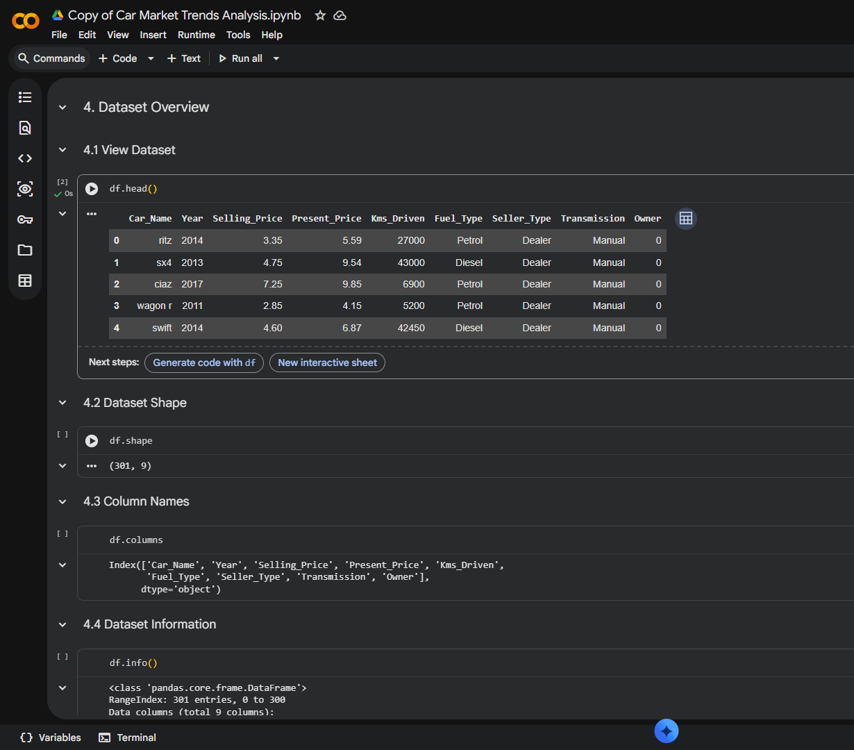
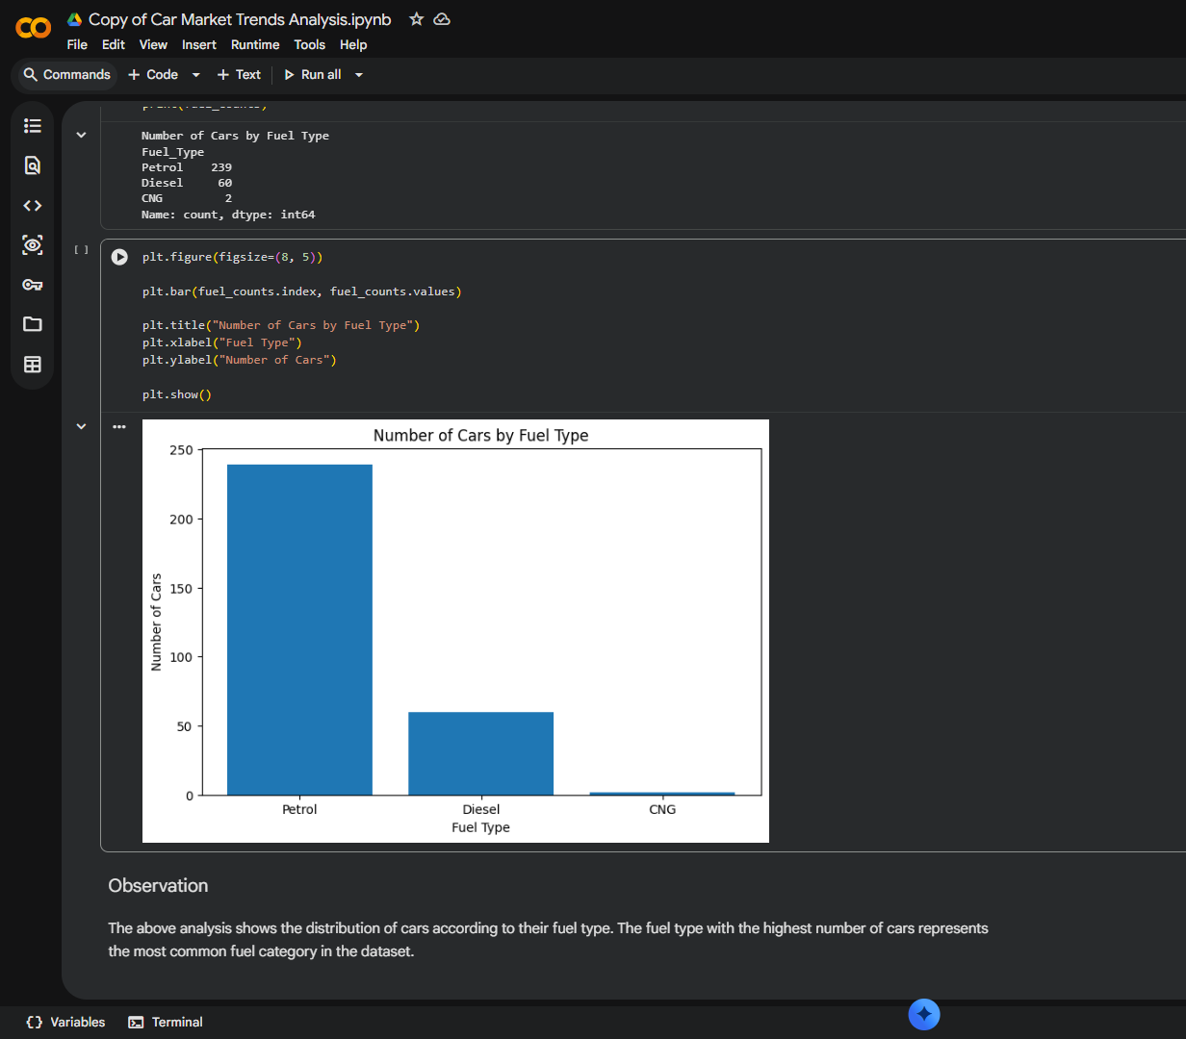
RESULTS
u
GitHub Repository

Slide 7
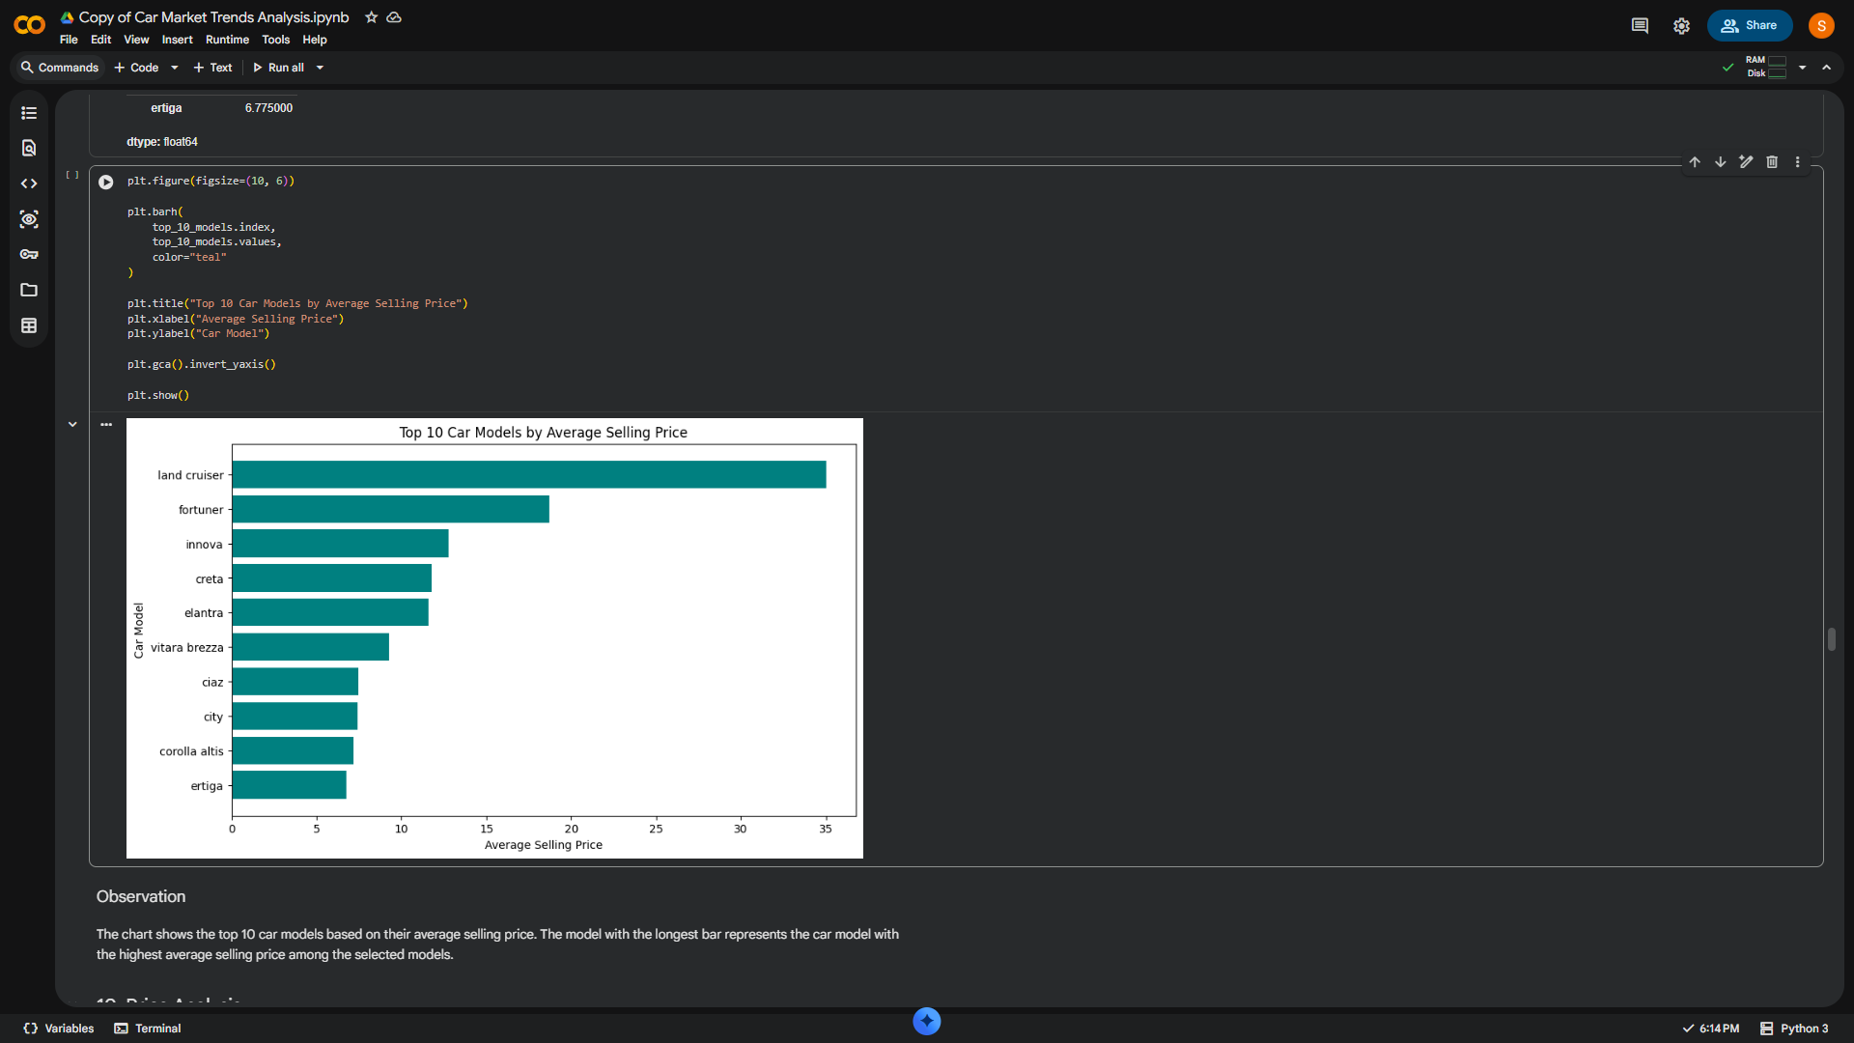
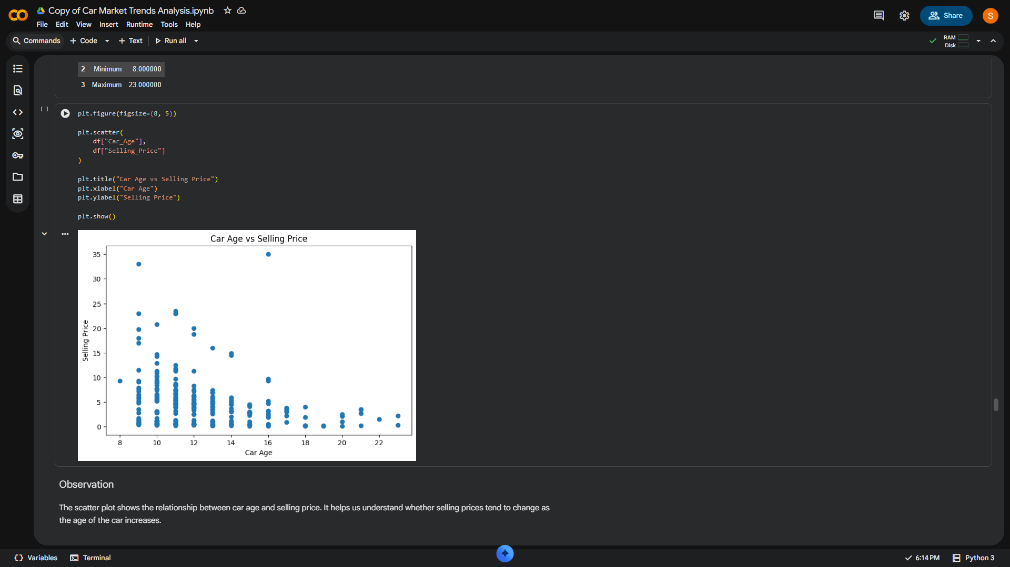
RESULTS
u
GitHub Repository

Slide 8
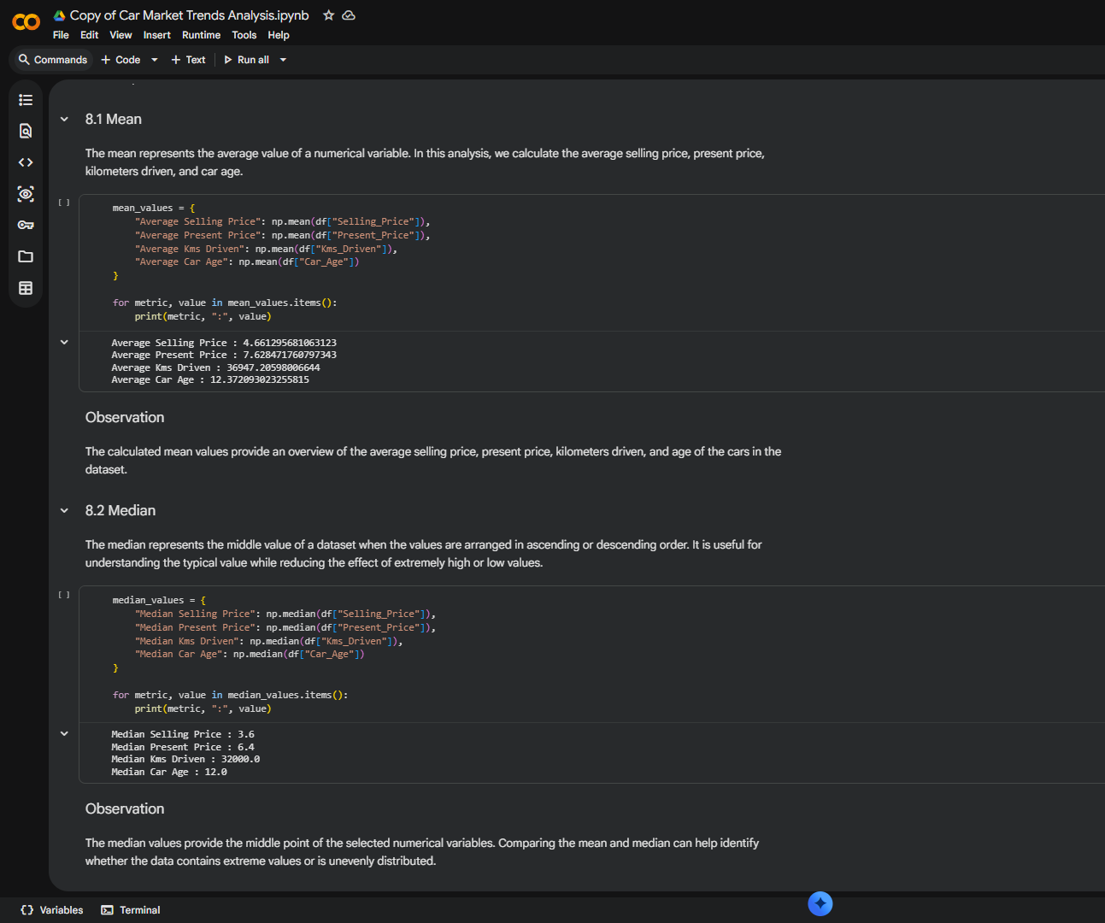
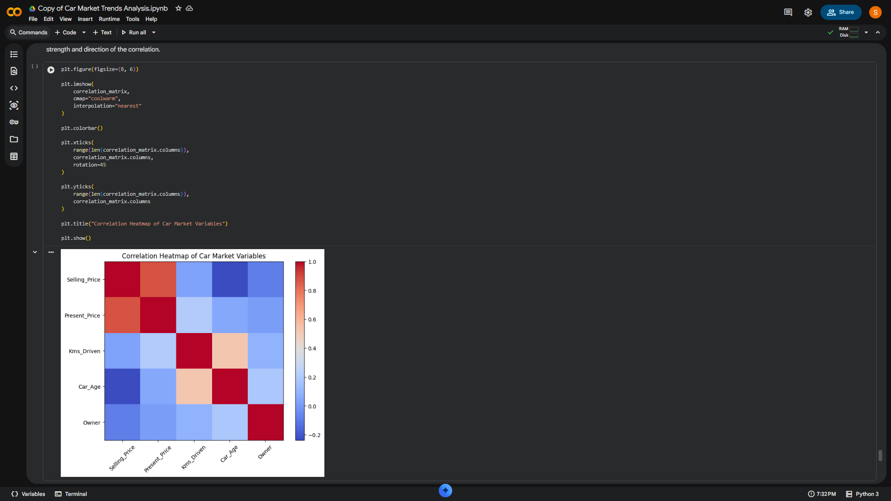
RESULTS
u
GitHub Repository

Slide 9
THANK YOU
Car Market Trends Analysis with Car Dekho Data
GitHub Repository
.
.

